Slide 1
Creating a Cyber Risk Intelligence Framework
Jack Freund, PhD

Slide 2
Risk Intelligence
“The organizational ability to think holistically about risk and uncertainty; speak a common risk language; effectively use forward-looking risk concepts and tools in making better decisions; alleviating threats; capitalizing on opportunities; and creating lasting value.”
— Leo Tilman
Common frameworks
Stitching together disparate data (internal and OSINT)
Using data to forecast future events (aka risk)

Slide 3
Cyber Risk Intelligence Overview
Overview of Integration Models
Incident Response Lifecycle
Threat Intelligence Lifecycle
Risk Analysis Model
Risk Variables Overview
FAIR
VERIS
Estimation
Rating Table Analysis and Process
Forecast Accuracy
Overall Process

Slide 4
Incident Response Life Cycle
Preparation
Establishing capability and technologies to enable response (or prevention)
Detection & Analysis
Reviewing precursors and indicators to identify and prioritize incidents
Containment, Eradication, & Recovery
Minimizing the collateral impact of confirmed incidents, removing components of the incident, and returning to normal operations
Evidence gathering and handling
Post-Incident Activity
Arranging data into facts, findings, and forecasts
Creation of actionable value-added briefings in any medium
Post-Incident Activity
Containment, Eradication, & Recovery
Detection & Analysis
Preparation
1. Adapted from NIST SP 800-61 Rev. 2

Slide 5
Threat Intelligence Cycle
Planning & Direction
Articulating the research questions and requirements
Defining what needs collected and why (5 Ws)
Collection
Planning for how this data will be captured (source identification)
Collecting the data required to answer the research questions
Processing
Turning raw data into Intelligence Information
Pre-analysis, collation, validity
Analysis/Production
Arranging data into facts, findings, and forecasts
Creation of actionable value-added briefings in any medium
Dissemination
Distribution of finished intelligence
Planning & Direction
Dissemination
Collection
Analysis and Production
Processing
1. Adapted from Krizan, L., H. (1999). Intelligence Essentials for Everyone. Joint Military Intelligence College

Slide 6
Risk Analysis Model
Intelligence Information
Threat Capability and Frequency
Threat Objectives and Goals
Risk Analysis Model
Greatest Risk Attack Scenarios
Intelligence Assessment & Surveillance Priorities
Attack Resource and Capability Requirements
Target Vulnerabilities & Attack Consequences
Detailed Attack Plans
1. Adapted from Willis, H. (2005). Using Risk Analysis to Inform Intelligence Analysis. RAND

Slide 7
Cyber Risk Intelligence Model
Planning & Direction
Dissemination
Collection
Post-Incident Activity
Analysis and Production
Processing
Containment, Eradication, & Recovery
Intelligence Information
Threat Capability and Frequency
Detection & Analysis
Preparation
Threat Objectives and Goals
Risk Analysis Model
Highest Risk Attack Scenarios
Intelligence Assessment & Surveillance Priorities
Attack Resource and Capability Requirements
Target Vulnerabilities & Attack Consequences
Detailed Attack Plans

Slide 8
Risk Variables for Threat Modeling
Risk
Loss Event Frequency (LEF)
Loss Magnitude(LM)
Threat Event Frequency (TEF)
Vulnerability
Primary Loss
Secondary Risk
Contact Frequency
Probability of Action (PoA)
Threat Capability (Tcap)
Difficulty
Secondary Loss Event Frequency
Random
Regular
Intentional
Value
Level of Effort
Risk
Skills
Knowledge
Experience
Resources
Time
Materials
Secondary Loss Magnitude
Variable | Sub-Variable | Definition
Threat Event Frequency |  | The frequency, within a given timeframe, that threat agents are expected to act in a manner that could result in loss
 | Contact Frequency | How often the threat agent comes in contact with an asset – characterized as random, regular, or intentional (targeted)
 | Probability of Action | Likelihood of threat agents to act in a manner that could result in loss (a function of the value of the asset under attack, level of effort necessary for an attack, and the attacker’s perception of their personal risk
Threat Capability |  | The level of force a threat agent is able to apply. Includes considerations of skills and resources.
1. Factor Analysis of Information Risk (FAIR)

Slide 9
Basic Threat Communities
Threat Community (TCom) | Definition | Metrics
 |  | Threat Event Frequency (TEF) | Threat Capability (TCap)
Nation States | State sponsored professional groups that are engaged in espionage and either clandestine or overt action. | The probable frequency, within a given timeframe, that the threat will act in a manner that may result in loss. Measured in number of times per year that an active attempt is made by this group Contributing factors Contact Frequency (random, regular, Intentional/Targeted) Probability of Action (likelihood over time that this group may act against asset). Must consider risk to the attacker (aka controls) | The probable level of force that the threat is capable of applying against an asset. Measured using a ratio scale (percentage). Contributing Factors Skills, access, resources, time, funding available to the threat Conceptually similar to administering a “hacker” test and reporting performance as a percentile (i.e., 90th percentile hacker)
Cyber Criminals | A generic term for any group of criminal enterprises or loosely organized criminals. They are reasonably well-funded but not as well as a nation state.
Privileged Insiders (Malicious) | People inside your organization with specific access levels, knowledge, or some other privilege for which they do not need to overcome any controls to cause harm. Also people in which the organization has placed trust such that if they wanted to do some harm, they could. Malicious – Those whom intend their actions to cause harm Error – Those who make mistakes that affect security M&A – Malicious activity during M&A scenarios
Privileged Insiders (Errors)
Privileged Insiders (M&A)
Non-Privileged Insiders (Malicious) | Everyone inside the organization who isn’t privileged. These are the people who have to overcome some form of resistive control in order to affect harm.
Hacktivists / Eco-Terrorist | Generic term for those that are interested in embarrassing and making moral, disciplined, or some other conscientious argument expressed through some cyber means.

Slide 10
Sample Threat Profile
Motive
Financial
Primary Intent
Monetize proceeds of successful attacks
Sponsorship
Usually None
Occasionally the beneficiary of state-sponsored intelligence (e.g. Russian KGB, Chinese government)
General Targets Types
Financial instruments and their issuing institutions
Specific Targets Types
Financial Services institutions
General Public
Preferred Targets
Liquid asset accounts
Payment cards
Concern for Collateral Damage
Limited
Capability
High degree of technological skill
Very high degree of social engineering skills
Personal Risk Tolerance
Moderate to High

Slide 11
Threat Rating Tables
Threat Community (TCom) | Threat Event Frequency (TEF) |  |  | Threat Capability (TCap)
 | Min | ML | Max | Min | ML | Max
Nation States | 0.04 | 0.05 | 0.10 | 95 | 97 | 99
Cyber Criminals | 4.00 | 6.00 | 12.00 | 85 | 90 | 95
Privileged Insiders (Malicious) | 0.05 | 0.20 | 0.10 | 99 | 99 | 99
Privileged Insiders (Errors) | 2.00 | 12.00 | 24.00 | 99 | 99 | 99
Privileged Insiders (M&A) | 0.50 | 2.00 | 6.00 | 99 | 99 | 99
Non-Privileged Insiders (Malicious) | 0.10 | 2.00 | 6.00 | 60 | 72 | 80
Hacktivists/Eco-Terrorist | 0.25 | 1.00 | 3.00 | 70 | 80 | 86
1 in 25 yrs | 0.04
1 in 20 yrs | 0.05
1 in 10 yrs | 0.10
1 in 5 yrs | 0.20
1 in 4 yrs | 0.25
1 in 2 yrs | 0.50
Hacktivist/Eco-Terrorist
Cyber Criminals
Nation States
Non-Privileged
Insiders
1
40
50
60
70
80
90
99
Highly Unskilled
Capability Continuum
Highly Skilled

Slide 12
VERIS Incident Classification Overview
A security incident (or threat scenario) is modeled as a series of events. Every event is comprised of the following 4 A’s:
Agent: Whose actions affected the asset
Action: What actions affected the asset
Asset: Which assets were affected
Attribute: How the asset was affected
Malware Hacking
Error misuse
Environmental
External
Action
Social Physical
Agent
Internal
Asset
Confidentiality Possession
Partner
Attribute
Availability Utility
Type Function
Authenticity integrity
The Incident Classification section employs Verizon’s A⁴ threat model
Incident as a chain of events
>
1
>
2
>
3
>
4
>
5

Slide 13
Mapping VERIS to FAIR
VERIS Variable | TCom | TEF | TCap | Loss Tables¹
Actor.external | Cyber Criminals Nation States Hacktivist | X
Actor.internal | Privileged Insiders Non-Privileged Insiders | X
Actor.partner | Suppliers | X
Action.hacking | Cyber Criminals Nation States Hacktivist |  | X
Action.malware | Any |  | X
Action.social | Any |  | X
Action.misuse | Privileged Insiders Non-Privileged Insiders |  | X
Action.error | Privileged Insiders Non-Privileged Insiders |  | X
Action.physical | Thieves |  | X
Action.environmental |  |  | X
Attribute.confidentiality |  | X | X | X
Attribute.integrity |  | X | X | X
Attribute.availability |  | X | X | X
Asset Enumerations | Build specific threat tables for each TCom by IT resource type | X
1. Although not part of threat modeling, we do consider this data in the maintenance of our Loss Tables

Slide 14
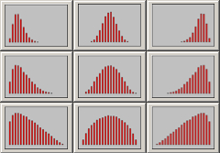
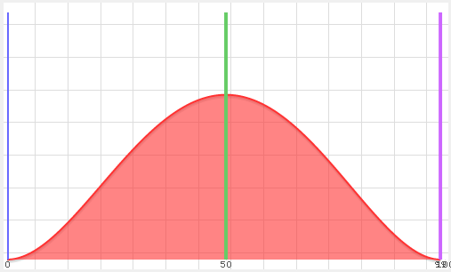
Determining Threat Values from SMEs
Values are estimated by SMEs informed by industry, and incident data (where available)
We estimate three values for each factor (Minimum, Maximum, and Most Likely/Mode) using these questions:
What’s the least it could be?
What’s the most it could be?
What’s the most likely value?
These three values allow us to make a curve that represents the field of possible values for this threat factor. From this, we can make some statistical inferences about how often an IT Risk incident may occur.
These values are then used to forecast losses for IT resources.

Slide 15
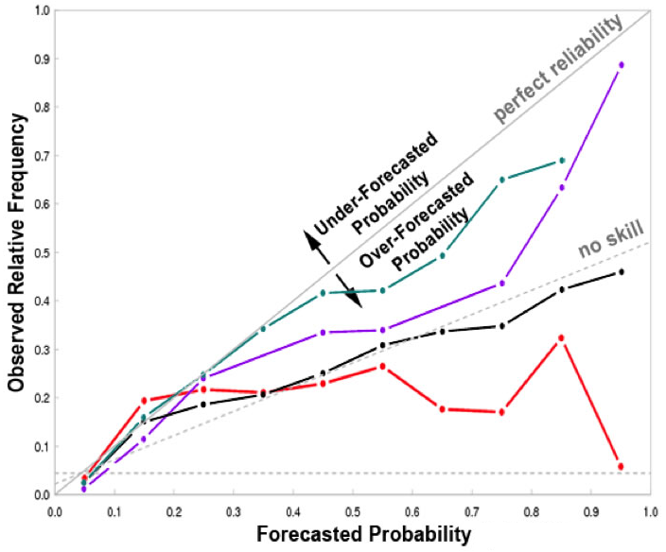
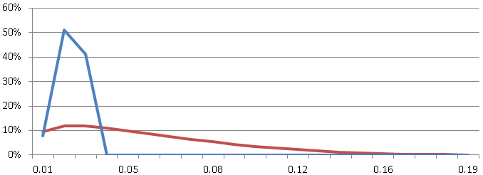
Updating SME Estimates with Forecast Accuracy Graphs (Brier Scoring)
N = # Forecast/observation pairs
f = Forecast Probability
o = Observed Probability
By comparing the current values against real incidents, we can compute how accurate our forecasts where (i.e. when we said we’d be attacked by insiders once in five years, is that how often we are really being attacked). If there are significant variances in these values, we can recommend changes to our rating tables to better forecast our loss exposure.

Slide 16
High Level Process and Responsibilities
Incident Mgmt App
VERIS Classification
Reporting
Rating Table Analysis
Rating Table Updates
Incidents
Incident Management
Incident Management
Incident Management
Risk Analysis
Risk Analysis
Risk Analysis

Slide 17
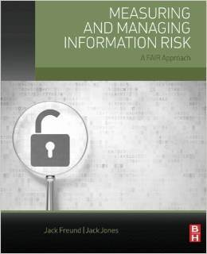
Jack Freund, PhD
@jackfreund3
linkedin.com/in/jackfreund
riskdr.com

