Slide 1
Dissecting Bitcoin Architecture and Security

Slide 2
Bitcoin Technology is Game Changer
Bitcoin != bitcoin
Decentralized != distributed
Censorship Resistant
Permission-less
Public transactions
Immutable record
Standardize way to talk money
Programmable money (for BTC)
Notes:
Most ambitious talk: explain bitcoin and its security features and provide examples how they could be used elsewhere.
Bitcoin is not only a currency. It's a system, a platform and an invention. Unfortunately they all have the same name. Currency is only the first invention using bitcoin, much like email was one of the first invention to use the internet.
If bitcoin the currency goes away tomorrow, bitcoin - the invention, won't be "uninvented". In theory the transaction scripting language in bitcoin can be used to do trust, escrows and much more such as income redistribution based on proof of state (e.g. taxation). You can use a pseudo currency to vote on a global basis. You can implement global lotteries, crowd funding, global stock market, bond systems.
We understand banking at the level people at the congress understand the internet.
1 - Bitcoin cannot be shut down. With 1 system you can recreate them all
2 – Anyone can join in (cannot prevent someone form getting an address)
3 – All transactions are recorded in a public ledger called blockchain
4 – Anyone can join the validation server pool
5 – Standardized way to talk money
7 – Smart contracts
Significant shift in the way we develop solutions and the way we secure them!
Blacklisting transactions won’t work
Reversing transactions won’t work
Authentication won’t work
Authorization won’t work
Shutting down some nodes won’t work (?)
Encrypting your transactions is not possible (they will appear in a public ledger)
At the sametime no central authority generated the address to the individual

Slide 3
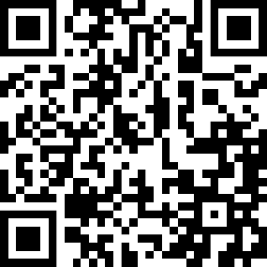
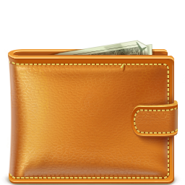
Bitcoin Overview Bob Sends 10 BTC to Alice
1CiSd827mA9K9GxFAz4ft2UM4xrjEsYzFt
Bob
Alice
Bitcoin “cloud”
Notes:
Here is the user experience.
Secret key for the private key in this slide: 5JDnmLkQ8Jnbrt5sEpFG9ErVymzSZP1DxLgfuMDw1SJTXw1MwGk

Slide 4
Bitcoin Overview Bob Sends 10 BTC to Alice
Bob
Alice
You received 10 BTC
1CiSd827mA9K9GxFAz4ft2UM4xrjEsYzFt
10 BTC
Bitcoin “cloud”

Slide 5
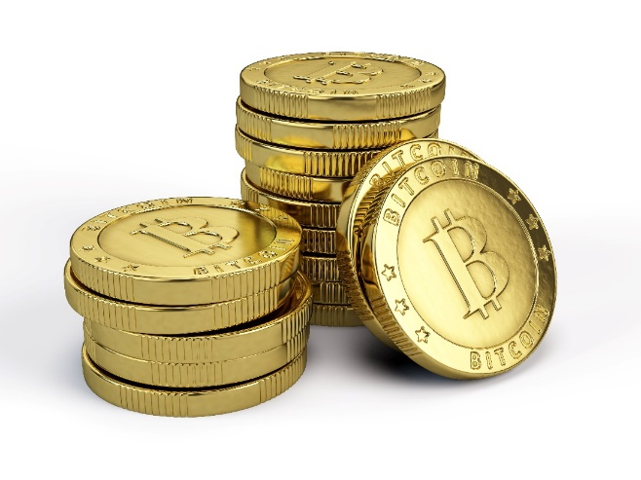
Bitcoin Misconceptions
Users
Coins
Wallets
Notes:
User: Drug dealer, anonymity, is human
Coins: divisible up to 4.2 quadrillion parts (1/100th)
Wallets: store keys and maybe unspent transactions
Transactions: verified independently (no central authority), stored by everyone.
1 – Amazon, Target, CVS, Subway, Zappos, Dell, Expedia accept Bitcoin. NCR silver accept bitcoins
There are 3 ways a new form of payment will succeed: exclusivity, new credit availability (extended credit) and bribery (miles, cash back, lower fees). During silk road Bitcoin had exclusivity.
2 – Bitcoin is probably the most tracked form of value exchange. Transactions can be unravel once a simple mistake is made such as providing a shipping address. Bitcoin is more trackable and less anonymous than cash.
3 – Bitcoin can be paid to a script. Bitcoin is programmable money! Money distribution can be triggered under certain conditions. It’s possible to create smart contracts with Bitcoin
Bitcoin Anonymity: http://blog.cryptographyengineering.com/2013/04/zerocoin-making-bitcoin-anonymous.html
Smart contract example: http://www.fastcolabs.com/3035723/app-economy/smart-contracts-could-be-cryptocurrencys-killer-app
Bitcoin is NOT anonymous. There is a serious flaw with the protocol. Because you can mine it forever, you can eventually pull out one purchase that can be associated with an identity and unravel the entire set of transactions associated to that identity. Bitcoin has the potential to become a totalitarian nightmare if this problem is not fixed.
For example, many addresses can be generated but once a purchase is made, many inputs may be used to create an output and this links all those addresses together. In addition a purchase may reveal someone’s physical address or the good can be uniquely identified revealing someone’s identity, even if timestamps and Ip obfuscation techniques such as the use of TOR are applied.
-----
1 - Wallets is a TERRIBLE metaphor! Wallets are key chains.
2 – Some wallets contain copies the entire blockchain. Someone’s don’t. Verification of transactions can disclose information when only some parts of the blockchain is requested.
wallet also contains a copy of the transactions that affect your balance. Here is a list of what’s contained in wallet.dat: https://en.bitcoin.it/wiki/Wallet
Type of Wallets: http://cointelegraph.com/news/111891/the-many-types-and-functions-of-bitcoin-wallets
------
1 – The golden coins are pretty worthless. They are symbolic much like patent plates.
2 – Bitcoin has as much value as any other fiat currency. Take you green bill out of the pocket. It has no objective value: you cannot each eat, you cannot drink it. The value is based on the belief everyone thinks that bill can be exchanged by, say, 10 bananas. If you can exchange bitcoins for real goods, it has value.
3 – Only transactions exit in the system
4 – Bitcoins are divisible to eight decimal places or 1/100 millionth of a bitcoin (aka one satoshi). 21 million coins will be generated by 2040.
Bitcoin has 2.1 quadrillion raw units

Slide 6
Pay to Public Key - P2PKH Bitcoin Addresses Are Derived From Public Keys
1
Randomly generate a 256 bit number
2
Generate public key using bitcoin’s ECDSA curve.
3
Public Key ➔ SHA256 ➔ RIPMD160 ➔ Base58 encode it (plus prefix + checksum).
4
1CiSd827mA9K9GxFAz4ft2UM4xrjEsYzFt
Notes:
No central authority (Keys are self generated 256 bit numbers).
Asymmetric system (compare with SSN, Passwords, credit cards)
Public key is protected. Key space is huge (Greater than the number of visible atoms in the universe).
Base58 (avoid typos + prefix, checksum)
…another type of address is pay to script hash…
There are many types of keys. P2PKH Pay to Public Key Hash is the most common. It starts with a 1. Pay to script starts with a 3, public keys with a 5, private keys with K or L and the new and upcoming Payment code with a P.
1 - An ECDSA private key d (an integer) and public key Q (a point) is computed by Q = dG, where G is a non-secret domain parameter. The random number in 1 is the private key. The curve used by bitcoin is secp256k1. The curve is not consider safe by http://safecurves.cr.yp.to/. Main reasons seem to be the non constant speed to calculate numbers and the fact the points have patterns that don’t look random (https://bitcointalk.org/index.php?topic=380482.0).
Tool to generate address: https://www.bitaddress.org/bitaddress.org-v2.9.10-SHA256-445e44cfd04c8f1ea8f732c3ae7277b0166fdb3e2109251c54e4b367983fe04d.html
A bitcoin address is not the same as a public key. Bitcoin addresses are derived from a public key using a one-way function. A Bitcoin address, or simply address, is an identifier of 26-35 alphanumeric characters, beginning with the number 1 or 3 (if it starts with 5 it’s a private key in WIF format).
Addresses are not wallets nor accounts, and do not carry balances. They only receive funds
Keys are self generated 256 bit numbers. This avoids the need for a central authority. The only thing that is enforced is the use of a specific ECDSA curve
There is a chance of collision but with 2^256 address (this number is greater than the number of visible atoms in the universe – 10^80 – it’s really hard to have a collision, at least in Theory). The curve is not consider safe (study why – see bookmark)
Hash: one way operation. There is no way to know the public key from the result. RIPMD produces a 160 bit value.
Two hash algorithms: extra security?
Base58 : Base64 without the confusing characters (“I” and “L”, “o” and zero, “+” and “/”)
Prefix is 00 in our case.
Checksum is prefix + payload hashed twice with SHA256 and the append the 4 bytes of the result to the end of the address. Done to avoid mistyping.

Slide 7
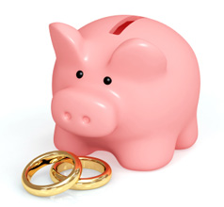
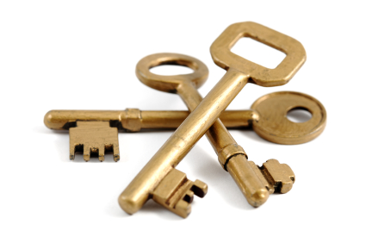
Pay-to-Script-Hash (P2SH)
Pay to a script matching the hash, a script that will be presented later when this output is spent
One of Two Signatures
Two of Three Signatures
Joint account
Backup
Business Partners
Extra Security
Notes:
Example: join account.
…let’s take a look how those addresses are created…
Multi-signature address script is the most common use
Requires M signatures from a total of N keys to spend the funds
1 of 2 signatures => a couple joint account
1 or 2 could be used for backup
2 of 3 signatures => no funds can be spent unless at least two business partners sign the transaction
2 of 3 could be used for security

Slide 8
P2SH Example: Bob Pays Alice 10BTC Alice Creates a P2SH address
Step 1 – Alice Creates Redeem Script
Redeem Script
=
<OP_1> <A pubkey> <B pubkey> <OP_2> <OP_CHECKMULTISIG>
Step 2 – Alice Creates Address by Hashing the Script
Script Address
Hash
To Address
39RF6JqABiHdYHkfChV6USGMe6Nsr66Gzw
Notes:
Forth like reverse-polish notation stack based execution language
Very limited in functionality – a deliberate security feature
No infinite loops or logic bombs
Hash = SHA26 followed by RIPMD160
Address = Prepend the hash with 05 and do a base58 (no checksum this time)
…the generated address is used the same way…
Step 1 – Assumes bob already has 2 keys.
OP_1 means 1 key out OP_2 needs to be presented
Bitcoin Script Language
Forth like reverse-polish notation stack based execution language
Very limited in functionality – a deliberate security feature
No infinite loops or logic bombs
Step 2 -
Hash = SHA26 followed by RIPMD160
Address = Prepend the hash with 05 and do a base58 (no checksum this time)
Frefresher: http://www.soroushjp.com/2014/12/20/bitcoin-multisig-the-hard-way-understanding-raw-multisignature-bitcoin-transactions/

Slide 9
P2SH Example: Bob Pays Alice 10BTC Bob Pays Alice, Exactly Like He Did Before
Bob
39RF6JqABiHdYHkfChV6USGMe6Nsr66Gzw
Alice
39RF6JqABiHdYHkfChV6USGMe6Nsr66Gzw
Bitcoin “cloud”
Notes:
Inside the transaction, a standard script is created <OP_HASH160> <redeemScriptHash> <OP_EQUAL>
Note: redeemScriptHash is just the bitcoin address with the decoded base58 and the “05” prefix removed.

Slide 10
P2SH Example: Bob Pays Alice 10BTC To Spend the funds, Alice needs to provide…
Alice
The Original Script
Signature for “A” Pubkey or “B” pubkey
Notes:
Here is what is needed to spend the coins.
…Now that we looked at addresses, let’s take a look at Wallets…
Transaction, amount and destination are also needed
1 - Original script is hashed and the hash is compared with the one in the transaction
2 – Signature is then compared with the pubkey in the original script
If 1 and 2 are satisfied, the funds are transferred.

Slide 11
Pay-to-Script-Hash (P2SH)
Fees and complexity of script are encumbered to the recipient (spender) of the transaction.
Person making the payment does not see the script.
Hides the complexity using hashes
Keeps the size of the transaction small
Keeps uniformity of transaction fields
Spender needs to include script to spend the money
Notes:
Scripting Language The bitcoin transaction script language, called Script, is a Forth-like reverse-polish notation stack-based execution language. If that sounds like gibberish, you probably haven’t studied 1960’s programming languages. Script is a very simple language that was designed to be limited in scope and executable on a range of hardware, perhaps as simple as an embedded device, such as a handheld calculator. It requires minimal processing and cannot do many of the fancy things modern programming languages can do. In the case of programmable money, that is a deliberate security feature.
Pay-to-script-hash addresses Another important part of the P2SH feature is the ability to encode a script hash as an address, as defined in BIP0013
Benefits of pay-to-script-hash The pay-to-script-hash feature offers the following benefits compared to the direct use of complex scripts in locking outputs: Complex scripts are replaced by shorter fingerprints in the transaction output, making the transaction smaller. Scripts can be coded as an address, so the sender and the sender’s wallet don’t need complex engineering to implement P2SH. P2SH shifts the burden of constructing the script to the recipient, not the sender. P2SH shifts the burden in data storage for the long script from the output (which is in the UTXO set and therefore affect memory) to the input (only stored on the blockchain). P2SH shifts the burden in data storage for the long script from the present time (payment) to a future time (when it is spent). P2SH shifts the transaction fee cost of a long script from the sender to the recipient, who has to include the long redeem script to spend it.

Slide 12
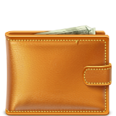
Bitcoin Wallets Types and Functions
Client Side Wallets
Application that runs in your PC. Can contain the entire blockchain. You manage and secure keys.
Old backups can disclose current keys
Incomplete wallets may disclose transaction information
Web Wallets
Your keys are stored on the web and protected by a 3rd party. Sometimes they look like banks
Centralization ➔ big target ➔ breach
Notes:
…wallets are key chains and key management is a vital aspect. Here is how addresses are created and managed…
Wallet Backups
An old copy of a wallet with its old password is often easily retrievable via an existing backup facility (particularly Apple Time-Machine): draining that old wallet, with its old password, drains the current wallet with the current password
Client side wallets: PC and mobile – mobile does not have the entire copy of the blockchain
Web wallets: “online banking” (good bye anonymity, hello bitcoin license), javascript encryption (store blobs – blockchain.info)
Critical to this security design is that secret keys never leave the HSM itself; all operations take place within the secure execution environment of the HSM. For example, when decrypting a message, the ciphertext itself is sent to the device, where it is decrypted using the private keys held by (and inside of) the HSM and the decrypted message is returned back. This is distinct from a non-HSM device that actually reveals the private key to the attached trusted client to “borrow” for performing some operation. It is a fundamental design objective of HSMs to never reveal keys, not even to trusted clients when connected.
Mobile Wallets do not download the entire blockchain due to the size. Instead they use Simplify payment verification (SPV).
Because it doesn’t have all transactions, it cannot verify double spending.
Could be used for Denial of Service (?)
To defend against this, SPV need to connect to random nodes
If the network is compromised, fake nodes can be easily created
SPV has potential privacy risks because it retrieves specific transactions.
Bloom filters allow SPV nodes to receive a subset of the transactions without revealing precisely which addresses they are interested in, through a filtering mechanism that uses probabilities rather than fixed patterns

Slide 13
Bitcoin Wallets Implementation
Non Deterministic (random) wallets
Just a bunch of keys
Need to back up keys frequently
Deterministic (Seeded) wallets
Seed + index or chain code is used to derive the private keys
All keys can be recovered with the seed

Slide 14
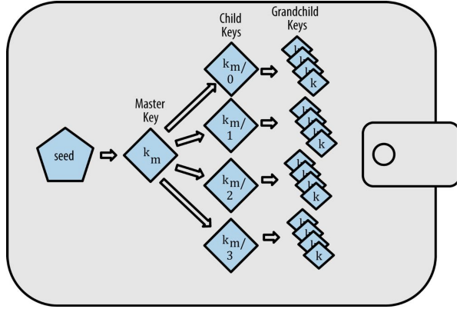
Bitcoin Wallets Implementation
Hierarchical Deterministic (HD) Wallets (BIP-44)
Parent key can derive a sequence of children keys
Branches can be used to only receive or to only spend funds
User can create public keys without having access to private keys
Graphic: Antonopoulos, Andreas M. Mastering Bitcoin: Unlocking Digital Cryptocurrencies
Notes:
Used in business banking - Entitlement, corporations
Private key = receive fund, public key = spend fund, chain code = create children
Traversing the addresses can provide you the total balance for all accounts
…Let me bring you to our initial example and dive deeper. Let’s now focus on payments…
BIP = Bitcoin Improvement Proposal.
Hierarchical wallets
Based on SHA512 and chaincodes. Basically it will combine a chaincode, a public key plus and an index to generate a 512 hash. The left part of the hash becomes the private key and the right part the child chain code. From a private key the public key is derived so the child can receive and spend funds. It will only be able to derive children if the chain code is provided.
Although there is no way for someone to know an HD wallet is being used, the owner of the master key can easily find the balances for the entire organization and a report of all transactions.
Because has is one way, child cannot find the parents public key. Because of the “random” chain code it cannot find it’s siblings.
-----
Can be used for business accounts (entitlement). An untrusted server can generate public keys because it won’t need access to the private key.
Root seed is a 128-, 256-, or 512-bit random number. Everything else is deterministically derived from this seed. This seed is hashed and using s SHA512 it generates 2 pieces of data: the private key (from the left 256 bits) and the chain code (from the right 256 bits). The chain code is needed to generate entropy – if only an index is used, it would be too easy for siblings to be generated without authorization.
Only the parent key who has the chain code can derive children. Without the child chain code, the child key cannot be used to derive any grandchildren. The child private key and the child chain code are needed to start a new branch and derive grandchildren. So what can the child private key be used for on its own? It can be used to make a public key and a bitcoin address.
Note that there is no way for someone who is looking at the keys to know a hierarchical deterministic wallet schema was used to created the keys. But with a schema like this, the owner of the master public key can find out the balance of the entire organization. It can also spend the funds for all organizations below.
Child private keys are indistinguishable from nondeterministic (random) keys. Because the derivation function is a one-way function, the child key cannot be used to find the parent key. The child key also cannot be used to find any siblings.
Without the child chain code, the child key cannot be used to derive any grandchildren either. You need both the child private key and the child chain code to start a new branch and derive grandchildren.
So what can the child private key be used for on its own? It can be used to make a public key and a bitcoin address. Then, it can be used to sign transactions to spend anything paid to that address.
There are two ways child public keys can be created: from the child private key, or directly from the parent public key. We’ve seen the creation from the child private key. BIP32 and 44 provides ability to derive public child keys from public parent keys, without having the private keys. This gives us two ways to derive a child public key: either from the child private key, or directly from the parent public key.
One common application of this solution is to install an extended public key on a web server that serves an ecommerce application. The web server can use the public key derivation function to create a new bitcoin address for every transaction (e.g., for a customer shopping cart). The web server will not have any private keys that would be vulnerable to theft.

Slide 15
Bitcoin Overview How Payments (transactions) Work?
Bob
Alice
You received 10 BTC
1CiSd827mA9K9GxFAz4ft2UM4xrjEsYzFt
Bitcoin “cloud”
Notes:
…Let me bring you to our initial example and dive deeper. Let’s now focus on payments…

Slide 16
How Payments Work? Essential Transactions Structure Overview
One or more inputs: | Unspent transactions Public Key, Signature
One or more outputs: | Addresses to pay, BTC
Timestamp: | <time, date>
Clear text transmissions allows for Packet Sniffing and Sibil attack (i.e. connect to fake nodes)
Transactions can contain arbitrary data ➔ could be used for exploit
Notes:
Sibil attack (attacker owns the network)
If the attacker controls the network, it could can make the victim connect only to fake nodes.
…The transaction moves the “bitcoin cloud”. Let’s take a peak inside!...
Packet sniffing
Someone who can see all of your Internet traffic can easily see when you send a transaction that you didn't receive (which suggests you originated it). Bitcoin-QT has good Tor integration which closes this attack vector if used.
Arbitrary data in bitcoin transaction
A transaction can contain arbitrary data, which could be used as the payload for an exploit.
Great page on transaction: https://en.bitcoin.it/wiki/Transaction
Inputs are previously received unspent outputs. They need to be signed to be used.
Outputs are payments. If there is a need for change, the payer need to output bitcoins back to himself
Transaction fees are implied. They are the result of inputs – outputs.
Fees are derived from the size (in kb) of the transaction, not it’s value.
If someone receives a lot of small donations and wants to spend all the change, the person will pay a large fee due to all the “fragmented” inputs used to make the purchase

Slide 17
Bitcoin Overview A Peek Inside the “Cloud”
Blockchain
Miner
Notes:
Miners with copies of the block chain
…Let’s look at the job of a miner…

Slide 18
Bitcoin Overview A Peek Inside the “Cloud”
The Job of miners
Validate new transactions and the work of other miners
Record the work in the blockchain
Rewarded fees
Earn BTCs for successfully mined blocks (coinbase transactions)
Proof of work
50% attack?
Resolved block does not need to be delivered immediately; Time sync issues
Notes:
Proof of work: We’ll talk about it in a few slides. What you need to know is that it takes:
Time (10 minutes on average)
Lots of electricity
Guesswork
…Let’s now dive into the structure of a block in the block chain…

Slide 19
Bitcoin Overview Blockchain
Simplified Block Structure
Block Header
Block 1435
Version Info
Nonce
Block 1434
Previous Block Hash
Timestamp
Block 1433
Merkle tree hash
Block 1432
Transaction id list
…
Notes:
Blocks are chained together by a previous block hash
Change a block and and the chain falls
Merkle tree is an optimization to transfer and verify data
…Generating the nonce is what the proof of work is about…
Explain in this order: Version, timestamp, merkle tree, previous hash and nonce
Scalability: Block size 1mb ➔ 7 transactions per second.
Time (10 minutes on average)
Lots of electricity
Guesswork
Version: indicates which set of block validation rules to follow
Nonce: An arbitrary number miners change to modify the header hash in order to produce a block header hash below the target threshold (difficulty threshold).
Previous Block Hash: A SHA256(SHA256()) hash of the previous block’s header. This ensures previous block CAN’T change without also changing this block’s header.
Timestamp: Must be greater than or equal to the median time of the previous 11 blocks. Full nodes will not accept blocks with headers more than two hours in the future according to their clock
Merkle tree: a hierarchical (tree) has of all transactions hashes (sha256(sha256(transaction)) included in the block. Ensures that none of those transactions can be modified without modifying the header
Target Threshold (difficulty): a number which a header hash must be equal to or below in order for that header to be a valid part of the block chain. The notation expresses the difficulty target as a coefficient/ exponent format, with the first two hexadecimal digits for the exponent and the next six hex digits as the coefficient.
For example: 0x1903a30c means an exponent 0x19 and a coefficient equals to 0x03a30c.
target = coefficient * 2 ^( 8 * (exponent – 3))
Using that formula, and the difficulty bits value 0x1903a30c, we get: t
target = 0x03a30c * 2 ^( 0x08 * (0x19 - 0x03)) ^ = > target = 0x03a30c * 2 ^( 0x08 * 0x16) ^ = > target = 0x03a30c * 2 ^ 0xB0 ^
which in decimal is: = > target = 238,348 * 2 ^ 176 ^ = >
target = 22,829,202,948,393,929,850,749,706,076,701,368,331,072,452,018,388,575,715,328
switching back to hexadecimal: = > target = 0x0000000000000003A30C00000000000000000000000000000000000000000000

Slide 20
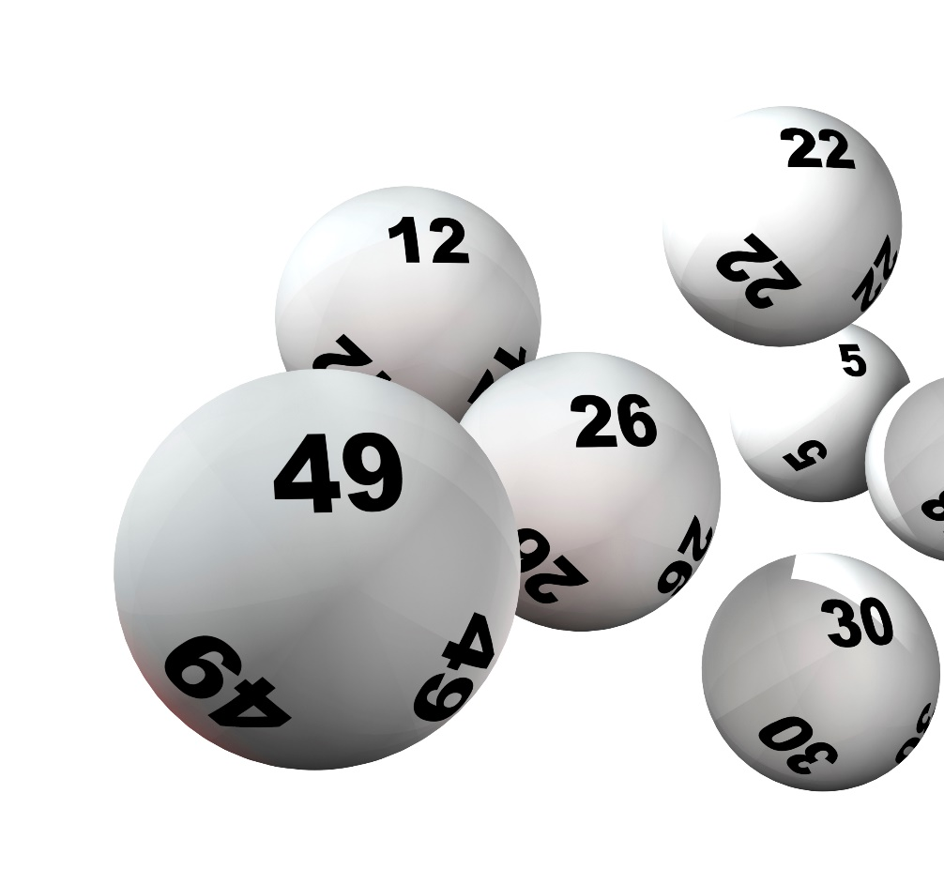
Proof of Work Like a Lottery or a Game of Sodoku
Proof of Work
Repeatedly hash the header of the block and a random number until the hash has a certain number of leading zeros.
A hard to solve problem
But easy to verify the result!
Keeps the generation of new bitcoins constant!
Notes:
Nonce: a number that will make the resulting hash have a certain number of leading zeros.
Like a lottery
Anyone can win
one can buy more tickets (machine power)
Like sodoku
Hard to solve, easy to verify
Programmed to take 10 minutes on average
…I’d like to take a couple of minutes to talk about alt coins…
We know that in approximately every 10 minutes bitcoins will be generated.
Prevents guessing and DDoS

Slide 21
Alternative Coins
Namecoin
A decentralized key-value registration and transfer platform using a blockchain. Alternative DNS.
Notary Services
Blockchain based solutions to store a proof of existence
Ethereum Frontier
Decentralized platform to create your own blockchain app.
Notes:
There are MORE alternate coins. Happy to talk about them outside after the presentation.
…In conclusion…
Enigma’s technique—what cryptographers call “secure multiparty computation”—works by mimicking a few of the features of bitcoin’s decentralized network architecture: It encrypts data by splitting it up into pieces and randomly distributing indecipherable chunks of it to hundreds of computers in the Enigma network known as “nodes.” Each node performs calculations on its discrete chunk of information before the user recombines the results to derive an unencrypted answer. Thanks to some mathematical tricks the Enigma creators implemented, the nodes are able to collectively perform every kind of computation that computers normally do, but without accessing any other portion of the data except the tiny chunk they were assigned.
Augur – prediction market based on blockchain

Slide 22
In Conclusion
Bitcoin is an invention with multiple uses
Different security models
Technology can be used in a open or closed way
It’s evolving fast… with a lot more to come!
Notes:
…keep an eye in the industry! Thank you!

Slide 23
Cassio Goldschmidt
Vice President
cgoldschmidt@strozfriedberg.com
+1 310.623.3270
linkedin.com/in/cassiogoldschmidt
@cassiogoldschmidt
strozfriedberg.com
E
T

